Slide 1
Effectively Design Create and Manage Workflows
Mitch Milam

Slide 2
Email
mitch@xrmcoaches.com
Twitter
@mitchmilam
Blogs
blogs.infinite-x.net ( developer )
rockmycrm.com ( user )
Tools
crmaccelerators.net

Slide 3
Workflows
Automation overview
What COULD you automate?
What SHOULD you automate

Slide 4
What to Automate
Internal actions
External actions
Both

Slide 5
How to Automate
Automatically ( started by an action )
On-Demand ( started manually by a user )

Slide 6
Automation Scenarios
New Lead from web site
New Opportunity > $1,000,000
New Case with Severity = Critical
Customer follow up three months after purchase
Happy birthday notification

Slide 7
Automation Scenarios
New Lead from web site
Assign the lead
Notify the new owner
Send a welcome message
Assign a follow up action with the owner

Slide 8
From: bjfsntifcno bjfsntifcno [mailto:gomret@pkhnge.com]
Sent: Friday, November 11, 2011 12:47 AM
To: mitch@crmaccelerators.net
Subject: CRM ACCELERATORS: Web site lead
First: bjfsntifcno
Last: bjfsntifcno
Email: gomret@pkhnge.com
Comment: R4ZDaO <a href="http://ktobyjlghqao.com/">ktobyjlghqao</a>, [url=http://vvjkttmvtkkg.com/]vvjkttmvtkkg[/url], [link=http://xgilmyvkshsc.com/]xgilmyvkshsc[/link], http://ezmkavyaeelo.com/

Slide 9
Automation Scenarios
New Opportunity > $1,000,000
Have management team verify deal
Email management
Contact the customer/prospect
Start the high-profile sales process

Slide 10
Automation Scenarios
New Case with Severity = Critical
Is new or existing case
Send email to customer
Send notication to case owner, case owner’s manager, support manager
Check to make sure somebody actually works on it
Workflow to follow case through life cycle

Slide 11
Automation Scenarios
Customer follow up three months after purchase

Slide 12
Automation Scenarios
Happy birthday notification

Slide 13
Managing Workflows
Navigating the System Jobs view
Creating a custom view to find halted workflows
Monitor and clean up completed workflows
System settings vs. bulk delete jobs

Slide 14
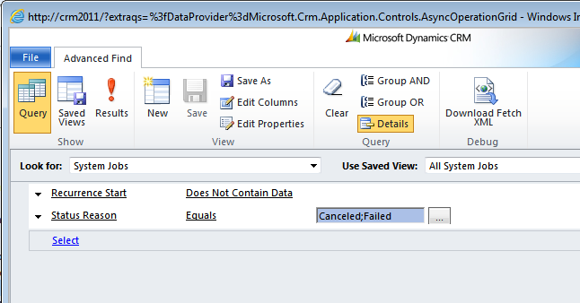
Locating Failed Jobs
Navigate to System Jobs
Create an Advanced Find query

Slide 15
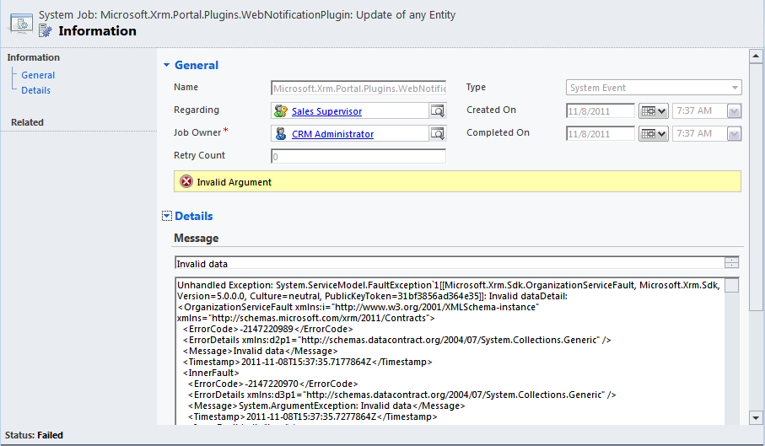
Failed Workflow Detail

Slide 16
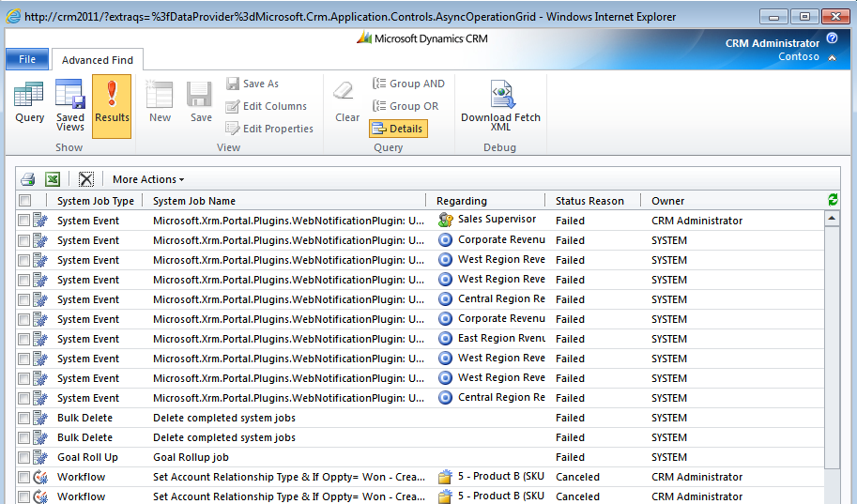
Search Results

Slide 17
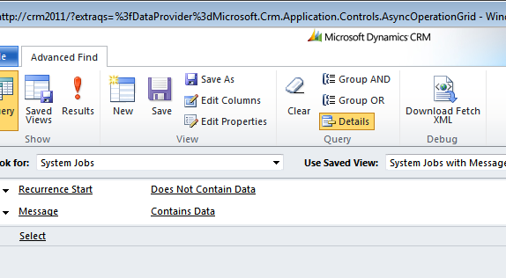
System Jobs with Message Query

Slide 18
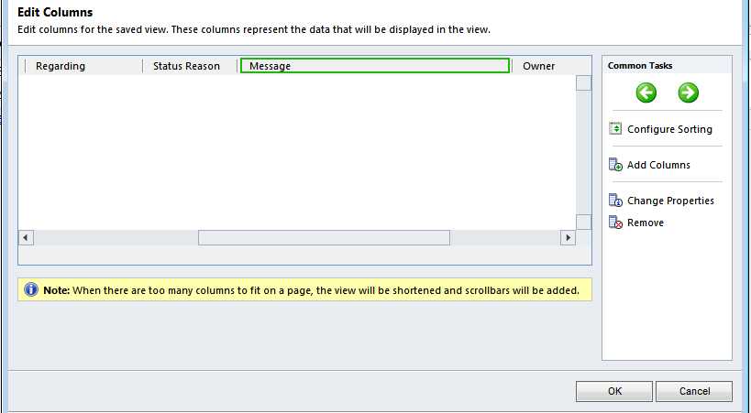
Query Column Set

Slide 19
Cleanup Options
Automatic ( per workflow )
Automatic ( per registry key )
Automatic ( via bulk delete job )
Manual

Slide 20
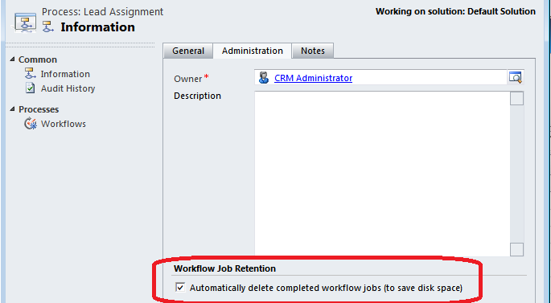
Workflow Job Retention

Slide 21
AsyncRemoveCompletedJobs Registry Key
The Workflow Expansion Task records cause the AsyncOperationBase table in the MSCRM database to grow too large in Microsoft Dynamics CRM 4.0
http://support.microsoft.com/kb/957871

Slide 22
AsyncRemoveCompletedWorkflows Registry Key
The AsyncOperationBase and WorkflowLogBase tables grow very large and performance issues occur when you use many workflows in Microsoft Dynamics CRM 4.0
http://support.microsoft.com/kb/968755

Slide 23
Stability issues with AsyncRemoveCompletedJobs
http://mscrmuk.blogspot.com/2010/12/stability-issues-with.html

Slide 24
Removing Old Asynchronous Operations
Performance is slow if the AsyncOperationBase table becomes too large in Microsoft Dynamics CRM 4.0
http://support.microsoft.com/kb/968520

Slide 25
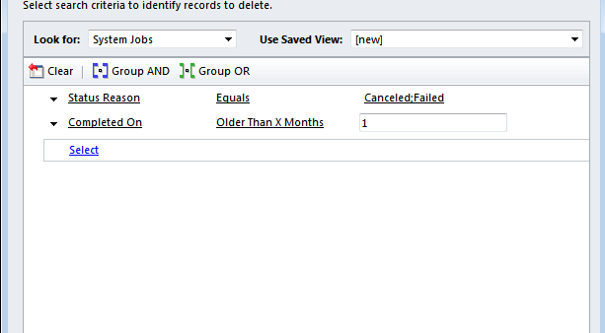
Bulk Delete Job

Slide 26
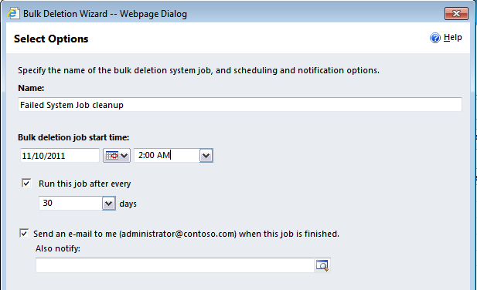
Bulk Delete Job

Slide 27
Q & A

